Slide 1
WILDLIFE CLASSIFIER

Slide 2
GROUP MEMBER
M.HASSAM BIN ZAHID 22SP-019-SE
RUBA SYED 22SP-053-SE
HURAIRA RIAZ 22SP-036-SE
ABHIA SULTANA 22SP-026-SE

Slide 3

MOTIVATION AND SCOPE

Slide 4
This project aims to revolutionize wildlife conservation by using AI for automated wildlife classification.
By collecting images, developing ML models, and deploying a user-friendly app, we'll enhance monitoring efficiency.
Field testing and documentation ensure effectiveness and continuous improvement.

Slide 5
PROBLEM STATEMENT

Slide 6
- Traditional wildlife monitoring is labor-intensive and time-consuming.
- Conventional methods are limited in scope and inefficient for large-scale data.
- This inefficiency hampers accurate tracking of wildlife populations.
- There's a need for an automated, scalable solution for accurate wildlife classification and monitoring.
- Such a solution would support conservation efforts and ecological research.

Slide 7
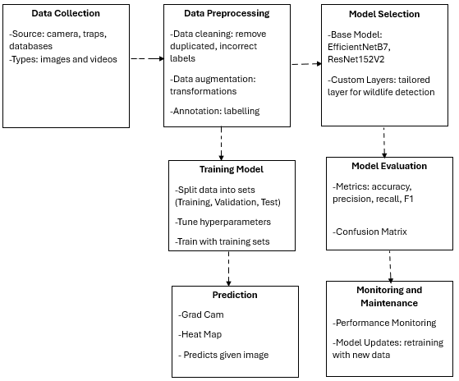
METHODOLOGY DIAGRAM

Slide 8
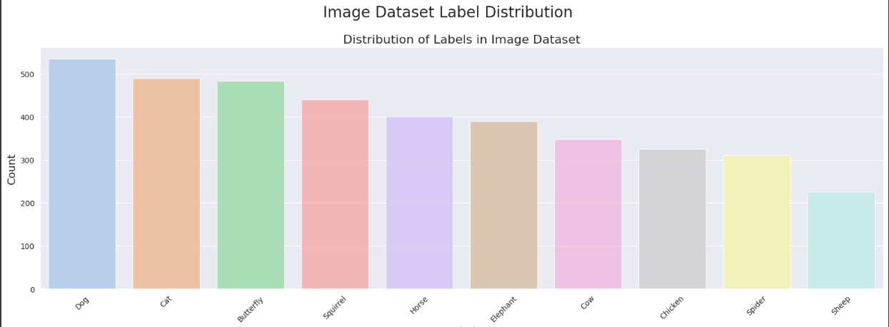
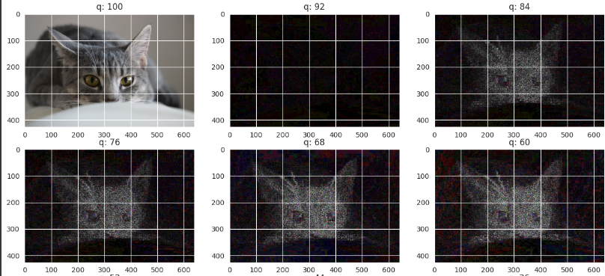
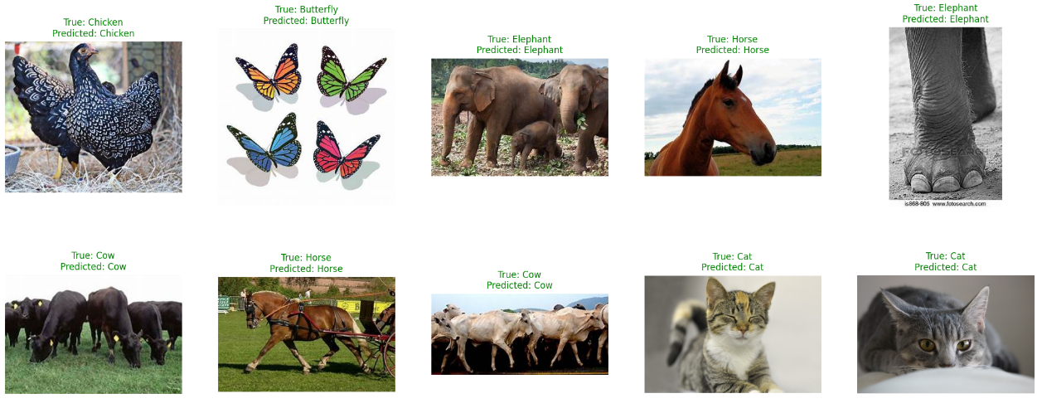
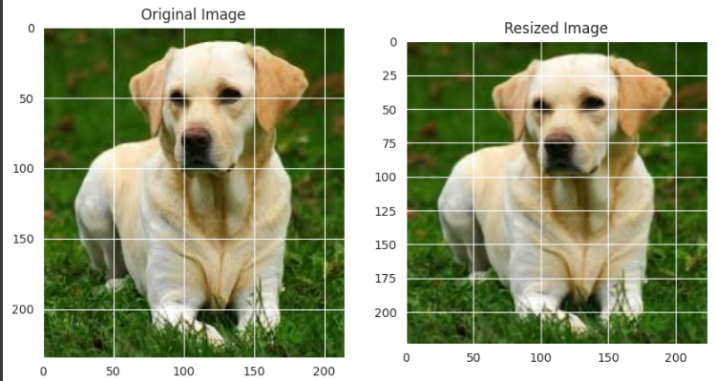
SOLUTION/CODING

Slide 9
EVALUATION
Accuracy: Percentage of correctly classified instances.
Precision, Recall, F1-Score: Assess ability to correctly identify positive results.

Slide 10
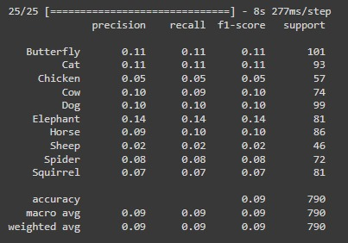
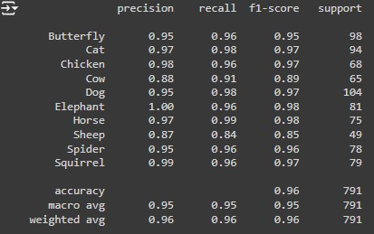
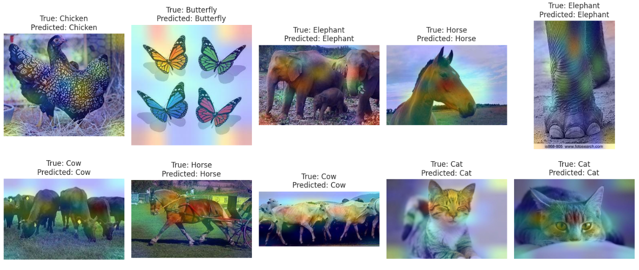
RESULT AND COMPARISON
The model processes the selected images, using Grad-CAM-generated heatmaps to highlight important regions, and makes predictions based on these insights. Its performance is evaluated through a confusion matrix, detailing true and false positives and negatives for each class, and a classification report that includes precision, recall, F1 score, and support. This comprehensive evaluation provides a clear understanding of the model's accuracy and effectiveness in classifying the images.
ResNet152V2
EfficientNetB7

Slide 11
CONCLUSION
-High Performance: High accuracy, precision, recall, F1-score, and AUC across datasets.
- Reliability: Effective in identifying wildlife species, enhancing monitoring and conservation efforts.
- Robust Tool: Supports informed decision-making and targeted conservation strategies.
- Generalization: Capable of generalizing to new data, practical for diverse ecological contexts.
- Broad Application: Advances wildlife research and related fields.

Slide 12
LIMITATIONS
-Slow GPU Performance: Leads to longer processing times.
- Network Dependency: Requires stable connections for accessing reference data.
- Delays in Results: Slow GPU and network issues may cause classification delays.
- Deployment Considerations: Hardware capabilities and network infrastructure are crucial for optimizing performance and reliability.

Slide 13
FUTURE WORK
-Algorithm Optimization: Improve image processing speed without compromising accuracy.
- Advanced Methods: Integrate transfer learning to enhance generalization and precision.
- Species Database Expansion: Collaborate to broaden the species database.
- Network Resilience: Implement strategies to handle network interruptions for enhanced reliability.

Slide 14
Thank you

